Slide 1
Module 2
Markov Decision Process

Slide 2
Agent,Environment
There is some agent trying to accomplish a task.
There is an environment in which the agent is operating.
Examples of RL:
Solving a maze:
Managing Investment Portfolio
Deciding among the pickup requests in cab-service scenario.

Slide 3
Note:
The agent is an abstraction(person/software/hardware controller) that is trying to learn the task.
While the environment is the world around the agent that gives it the feedback.
Agent has no control over the environment.The only way agent interacts with environment is by taking an action.The agent can only watch the consequences of the action.

Slide 4
Agent-Environment Interaction
Agent Environment
Action
Observation
Agent observes the environment, then takes an action which he thinks is good. After taking the action, the environment tells him how good that action was, in the form of rewards; this also presents a new observation to the agent.
*Quiz

Slide 5
Two types of tasks:
Continuous: tasks that do not have a definite end - e.g. learning to walk, controlling a chemical plant, driving a car
Episodic tasks: tasks that have a definite end - e.g. most games (videos games, Chess, Ludo) etc. are episodic since at the end of the game the agent either wins or loses.

Slide 6
State Vectors
A state is a representation of the environment at any point in time. The environment will give all the signals, but how relevant those signals are for the agent to take an action is what you have to decide. We can consider state vector as a list of features that help the agent to take an action. For each RL problem, state vector would be different.
Example:
1.Investment Management Portfolio
2.Cab Driver Problem
*Quiz

Slide 7
Objective of RL Agent
The objective of episodic tasks is to find such a sequence of actions that will make the majority of episodes successful.
For continuing tasks, break it into multiple episodes and then find out actions that maximise the average rewards earned from those episodes.

Slide 8
Quiz
1.Which of the following is/are incorrect? More than one options may be correct.
a)The objective is defined after observing the state vector from the environment.
b)Just like the reward, the objective is also a property of the environment.
c)The objective of RL agent in an episodic task is to find such sequence of actions that will make a majority of episodes successful.

Slide 9
2. A self-driving car gets rewarded for every 1km of a ride. And after every 8 hours, it needs to charge itself.
Which of following is the correct objective of a self-driving car?
Find out how much traffic is there today
Find out an action sequence that could accumulate maximum rewards in maximum rides
Find out an action sequence that would make the average hourly ride smooth.
None of these

Slide 10
Actions & Policy
So far, you have two pieces of information:
An action leads to a reward and a change in state.
The objective of the RL agent is to find the sequence of actions to maximise overall rewards.
Both have something in common which we have still not discussed in detail – actions.
How does an RL agent take an action from a given state? Are there some rules defined for each scenario? Or is there some mathematical model of the environment which the agent learns over time and then takes an action?

Slide 11
Agent needs to learn about the environment before it behaves in an optimal manner. Learning essentially means that the agent interacts with the environment by trying out different actions and understanding their consequences. The consequence is two-fold, one in form of rewards, other in form of change of state.
It is like a child learning how to walk. He needs to understand which foot to put forward, to keep both the legs straight, etc., and the consequence for each of these. So, he will remember what action he took and what consequence it led to. This memory of action and consequence is called knowledge-base or history for an RL agent.
Now, the agent can look up in its knowledge base and see which action leads to the best consequence when in a given state. We could also build a mathematical model of the environment rather than storing all possible (action, consequence) pairs.
All this is good for smaller problems where there are very few states and actions. In more realistic situations, it is very difficult to explore all possible states and actions and therefore makes it difficult to build a knowledge base or a model.

Slide 12
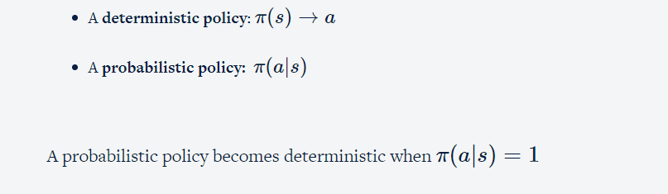
A policy is a set of rules which helps the agent decide the action that it should take in a given state such that the agent can maximise its rewards in the long run. There are two types of policies:

Slide 13
Consider the cab service scenario: The current state of cab is (09:00am, 1st January, Point A). He gets a request in the form of (pickup, drop). Let's say he has gotten two requests which he has to choose from: (Point A, Point B) and (Point C, Point B).
1)Consider, he services the second request. What will be the consequent state after completing the ride?
(12:00pm, 1st January, Point A)
(12:00pm, 1st January, Point B)
(12:00pm, 1st January, Point C)

Slide 14
Consider the cab service scenario: The current state of cab is (09:00am, 1st January, Point A). He gets a request in the form of (pickup, drop). Let's say he has gotten two requests which he has to choose from: (Point A, Point B) and (Point C, Point B).
2)Consider, the reward is calculated as (amount of cash earned during the trip – amount of fuel burnt). Assume Point A, B and C are equidistant from each other, so the amount of cash earned from Point A to Point B and Point C to Point B is the same. In which of the following cases, the reward earned is more?
From Point A to Point B
From Point C to Point B
It is same in both cases

Slide 15
Consider the cab service scenario: The current state of cab is (09:00am, 1st January, Point A). He gets a request in the form of (pickup, drop). Let's say he has gotten two requests which he has to choose from: (Point A, Point B) and (Point C, Point B).
3)Consider two cab drivers are in a state s = (09:00 am, 1st January, Point A) and they could service two actions:
Action 1: (Point A, Point B)
Action 2: (Point C, Point B)
The policy for one cab driver is deterministic in the sense that no matter the time or day, he will never pick a customer from Point A. That implies π(s) -> action 2.And for other cab driver, it is stochastic: π(action1|s) = 0.3, π(action2|s) = 0.7. And given that rewards are calculated as per the previous question, which driver could get a chance to earn more profit ?(Assume Point A, B and C are equidistant from each other, so the amount of cash earned from Point A to Point B and Point C to Point B is the same.)
First cab driver
Second cab driver
Both will get an equal chance

Slide 16
4.Which of following correctly defines a policy?
A mapping from state that helps the agent to figure out what action needs to be taken
A set of variables that define what is the current situation of the environment
Policy is another terminology for defining RL objective

Slide 17

Exploration vs Exploitation
Let's say you love Indian food. You have the following policy (based on, say, Zomato reviews) to choose a restaurant when in a given mood
This is your current policy. Say, you are happy, and you decide to go out for a family dinner. The most obvious choice is “Smoke House Deli” as per the policy. Now, on some day, you thought of giving “Delhi House” a try. You went there, and you loved the food much more than that of “Smoke House Deli”. If you wouldn’t have ‘explored’ this option, probably, you would have never had that tasty Indian food!

Slide 18
Q1)What is exploitation?
Exploiting the current option which you already know is reaping benefits
Finding out other options
Both a and b
Q2) Investment Management Portfolio: Consider you know which stocks will always reap benefits. And you invest your money there. Will you always risk your money there? Will you never explore? What if there exists some stock which is reaping 200% profits?

Slide 19
Markov State
Given a state, an agent takes an action according to a policy. The action leads to a change in state and possibly generates a reward. One bruteforce way to learn a policy is to actually remember all the possible pairs of state, action and reward. But that is often not feasible. For example, in a game of (say) Chess, this set may comprise of a million possible combinations. In more complex problems (such as playing Go, driving a car etc.) this may be further intractable. Therefore, in the RL problem, we make a Markovian assumption.
The Markov assumption states that the current state contains all the necessary information about all the past states the agent was in and all the past actions the agent took. It assumes that the current state is sufficient for taking the next action.

Slide 20
Let’s consider a robot learning to fly a plane. It has the knowledge base of position, the speed at each and every time step. Now, at some position, the robot makes a right turn. The next state of the plane will be dependent on what the current position and speed of the plane are, and the robot has taken the right turn. It doesn’t need to know how it arrived at the current position or how it gained its current speed. Its current state vector (current position, current speed) and action satisfy the Markovian assumption.

Slide 21
1)Which of following statements are correct about Markov state?
a)Markov state contains all necessary information that helps to predict the future state.
b)Markov state doesn’t contain necessary information to take the next action
c)All the above
2)Inventory Management Problem: Say you are the owner of a retail shop. Your objective is to maximise the profits earned in a day. So, you need to place an order to meet the demand. On any day, you observe the ‘state vector’ and take an action for placing an order (from supplier) which arrives later the next day. Assume that your demand is a function of day of the week.
State for this problem is (current stock level, day-of-week). Is this state Markov?
a)Yes
b)No

Slide 22
Let’s encapsulate the learning so far.
The following points apply to an RL problem:
An agent learns how to behave in an environment by taking actions.
Then observing the consequences (rewards and next state), of the action taken.
The control objective of the agent is to learn a policy to accumulate maximum cumulative rewards over a period of time.
All of RL problems are based on the Markov assumption: the current state contains all relevant information to take the best action.

Slide 23
1.A policy is a mapping from perceived states of the environment to actions to be taken when in those states.
a)True
b)False
2.Rewards are the property of agent.
a)True
b)False
3.Stochastic policy is generally preferred over deterministic. Which of following options justify the statement? More than one options may be correct.
a)Stochastic policy gives a chance to explore, whereas deterministic does not
b)Stochastic policy provides an edge over deterministic by allowing to choose some less probable actions
c)Deterministic policy helps to exploit the best possible action known. There’s no need to explore
d)Stochastic policy is easy to handle as only one action can be taken from a state

Slide 24
4.What is Markov in Markov Decision Process?
a)The state vector
b)Actions
c)Policy
d)Rewards
5.Say an RL agent is trying to learn to play the game of tic-tac-toe. What could be the Markov state in this case? Choose the most appropriate option.
a)The current position of all X's
b)Positions of all X’s and O’s
c)The current position of all O's

Slide 25
6.Say an RL agent is trying to learn to play the game of tic-tac-toe. The opponent is playing with O. What is the objective of RL agent?
a)Find a sequence of actions that will help him win maximum number of games
b)Find the next best state after taking an action
c)None of these

Slide 26
Markov Decision Processes (MDPs)
A Markov decision process (MDP) refers to a stochastic decision-making process that uses a mathematical framework to model the decision-making of a dynamic system. It is used in scenarios where the results are either random or controlled by a decision maker, which makes sequential decisions over time. MDPs evaluate which actions the decision maker should take considering the current state and environment of the system.
The word ‘Decision’ in MDP takes into account actions taken by the agent in a given Markov state. MDP is the formal name of a sequential decision-making process. All the RL problems set its ground on MDPs, i.e., work on the assumption of the Markov property.

Slide 27
Value Function
Let’s say an agent is learning to play a game where it has to fight enemy's drones in a battlefield. Assume that his current location and the number of bullets in his gun defines his state. His action could be - to move forward or to shoot. The reward is the number of drones he shot without getting killed. Let’s say he found a position behind a wall and he can shoot as many drones as he wants without getting killed.
The position behind the wall has offered him an advantage and is more valuable to him. On the other hand, the agent once found himself out in the middle of the battlefield where he was an easy target for the drones.
This implies that some states are inherently more valuable than others, i.e. the agent prefers some states over others. It will be useful if the agent learns the 'values' of all these states.

Slide 28

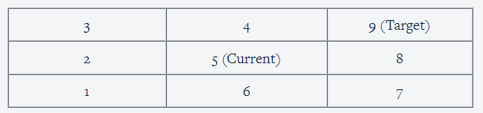
1.State value function
π
(
s
)
Value function helps in evaluating a state. Consider the following table.
Assume that you want to reach cell 9 from the current state (which is cell 5). Assuming you can take actions only from the following set {Left, Up, Down, Right}, the possible next states you can be in, starting from cell 5, are - cell 2, cell 4, cell 6, cell 8. You evaluate all the states, based on how valuable each of these states would be in achieving the final goal of reaching state/cell 9.
Clearly, if you move to cell 4 (or 8), the chances of reaching cell 9 in the next step are higher than if you were in cell 2 or 6.
The positional advantage you have simply by being in a particular state is the intrinsic value of the state. For example, it is far more valuable to be in state 4 as opposed to state 3, because the immediate step after 4 will result in achieving the target i.e. state 9. So, state 4 is inherently more valuable than state 3. So, you can select an action that helps you achieve the state with the maximum 'value'.

Slide 29
A value function tells you how good it is for the agent to be in that particular state. It is also known as the state value function. The agent would want to be in a state such that its total rewards (immediate + expected future rewards) are maximised.
Total rewards
Consider that the agent starts from state S0, takes an action A0 and gets an immediate reward of R0 and ends up in state S1. From there he takes action A1 and so on. So, his episode is:
(S0, A0, R0), (S1, A1, R1), (S2, A2, R2), (S3, A3, R3), (S4, A4, R4), S5
where S5 is the terminal state.
Now, you want to calculate total rewards earned from State S2, that will be: (R2)+ (R3+R4). Here R2 is an immediate reward and (R3+R4) are future rewards.

Slide 30

2.Action value function
We can define a value function for action, i.e., define how valuable it is to perform an action in a particular state. Consider the game of chess - we move our rook to take the opponent’s queen and got an immediate high reward for this move. But taking this action might have been useful in some other state, but in this state (where the King gets endangered) this action is quite unfavorable.We take actions that bring about states with high value, i.e. actions that fetch high immediate reward + expected future rewards because these actions bring the greatest amount of reward over the long run.

Slide 31
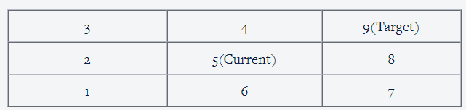
Consider the above example: If you (the agent) are in state 5, let’s say you have the choice of performing 4 actions in that state. You can go either left, right, up or down. All actions are not equally valuable. Some actions can make you closer to the target. So, in state 5, actions ‘up’ and ‘right’ will take you closer to the target cell 9, while the actions ‘down’ and ‘left’ will take you away from the target cell. So when you are in state 5, actions ‘up’ and ‘right’ are more valuable.
This function calculates the intrinsic value of performing an action when we are in state ‘s’.
Also known as the q-function, q(s, a) is the reward you can expect if you take an action ‘a’ in state ‘s’.

Slide 32
1.State True/False - “Value function Q(s,a) represents how good it is for an agent to be in state ‘s’”.
a)True
b)False
2.Reinforcement learning agent aims to maximise a numerical value which represents the long term reward of a state. What is that numerical value?
a)Value function
b)Reward
c)Policy
d)All of the above

Slide 33
3.Action choices are made based on immediate reward obtained.
a)True
b)False
4.Value function V(s) represents how good an action a is when in state s:
a)True
b)False
5.The state-value function and action-value function reflects the expected total reward and not the immediate reward.
a)True
b)False

Slide 34


Optimal Policy
The objective of an RL agent is to find the best action to take in a given state, i.e. to learn an optimal policy.
A policy π is called optimal only if ∀ π :π ∗≥π
For every possible policy ,π ∗ is at least as good as π.
But, π is just a mapping (of what actions to take in a given state). How can we compare two mappings? We must have some metric to say one policy is better than another.
Policy π is better than π′ if, for all states, the value function is higher if you follow policy π than if you follow policy π′
( : expected future rewards of being in state s and following policy π )
Mathematically,

Slide 35

Model of the Environment
Model is represented by
There are broadly two types of frameworks in RL: model-based and model-free.
In model-based methods, it is possible to learn what is called a model of the environment, i.e. a model which maps the consequences (next state, reward) of taking an action in a state.
In model-free methods, it is not possible to learn an explicit model (which is a more realistic case).

Slide 36
Q. Which of following correctly explains the difference between policy and model of the environment?
Policy defines which state the agent will land into and what reward it will get for taking an action from state s; whereas model of the environment defines what action the agent should take from a state.
Model of the environment defines which state the agent will land into and what reward it will get for taking an action from state s; whereas policy defines what action the agent should take from a state.
Environment is stochastic and an agent can see any future state s and reward r after taking action from state. To handle this we make our policy deterministic.
None of these

Slide 37
Markov Decision Process
An agent is learning to play the game of chess. His policy is deterministic, i.e. when in state s he always takes the action a. According to him, everytime he takes the action a in the state s, he should end up in the same new state s' and get the same reward r. However, this is not the case. Each time he is taking the action a in state s, he is landing in a very different new state (which is not s') and getting a very different reward (which is not equal to r).
Why is he getting a different reward and a different next state on taking the same action in state s?
The environment is deterministic.
Environment is stochastic
Policy is stochastic
None of these

Slide 38
Which of the following statements is incorrect?
In deterministic policy, you can take only one action from a state. Whereas in stochastic policy, there is a probability distribution that defines what all actions can be taken from a state.
In stochastic policy, you can take only one action from a state. Whereas in a deterministic policy, there is a probability distribution that defines what all actions can be taken from a state
Stochastic policies are inherently exploratory in nature, whereas deterministic policies are exploiting
All of these

Slide 39
Which of the following correctly defines the model of the environment?
The probability of ending up in state s' and getting immediate reward r, after taking action a from state s.
The probability of taking an action from state s.

Slide 40
Fundamental Equations in RL
Learn some of the fundamental equations in Reinforcement Learning.
Learn how to calculate value function (of a state) and also the q-value (of a state-action pair).
Understand the concept of discounted rewards.
Learn how to find an optimal policy for a given RL problem. We will learn about Policy Improvement Theorem. These equations and their ideas will be used later when we apply model-based techniques (such as Policy Iteration or Value Iteration) or model-free methods (such as Monte-Carlo & Temporal Difference).

Slide 41
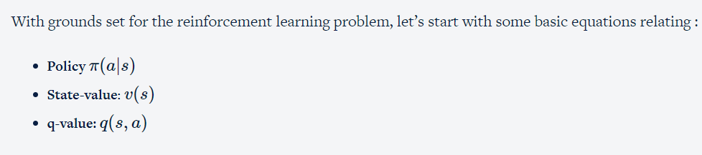
RL Equations-State Value Function

Slide 42
Expected value from state s
Let's try to understand this through the game of Chess:
Every time you play the game starting from the same board position (same state) and with the same policy (stochastic or deterministic), the end outcome will be different (total rewards will be different) because you don’t know how the opponent is going to play. In most of the scenarios, the environment is stochastic (the opponent’s move will decide the agent’s next state which is not deterministic), so every time you run an episode from the state s following policy π, you will get different immediate and future rewards, thereby different total rewards.
Hypothetically, say you get a total reward of 10, 20, 15, 5, 30 in the first 5 games starting from the state 's'. The average reward is 16. What if the game is played infinite number of times, what will the average be? According to the law of large numbers, the average value will converge to the expected value.The same principle applies here. If you run a large number of episodes (play a large number of games) from the state s following the policy π, the expected total reward will be the value of that state under the policy π .

Slide 43
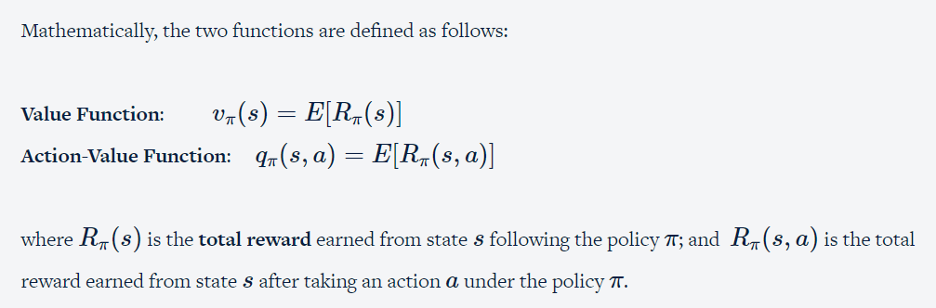

Slide 44
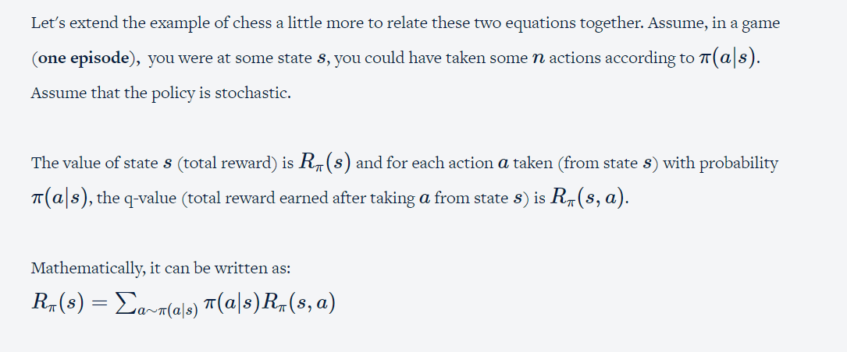

Slide 45
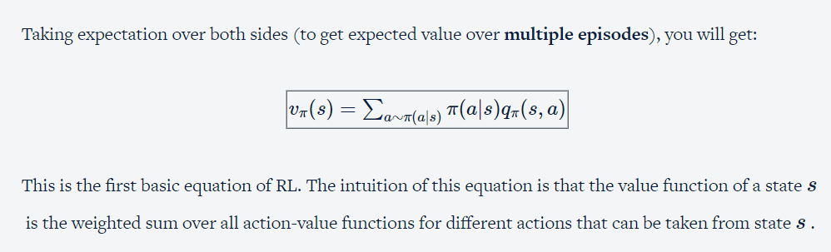

Slide 46


RL Equations - Action Value Function
We know the equation:
We will learn to create a similar equation for action-value function

Slide 47
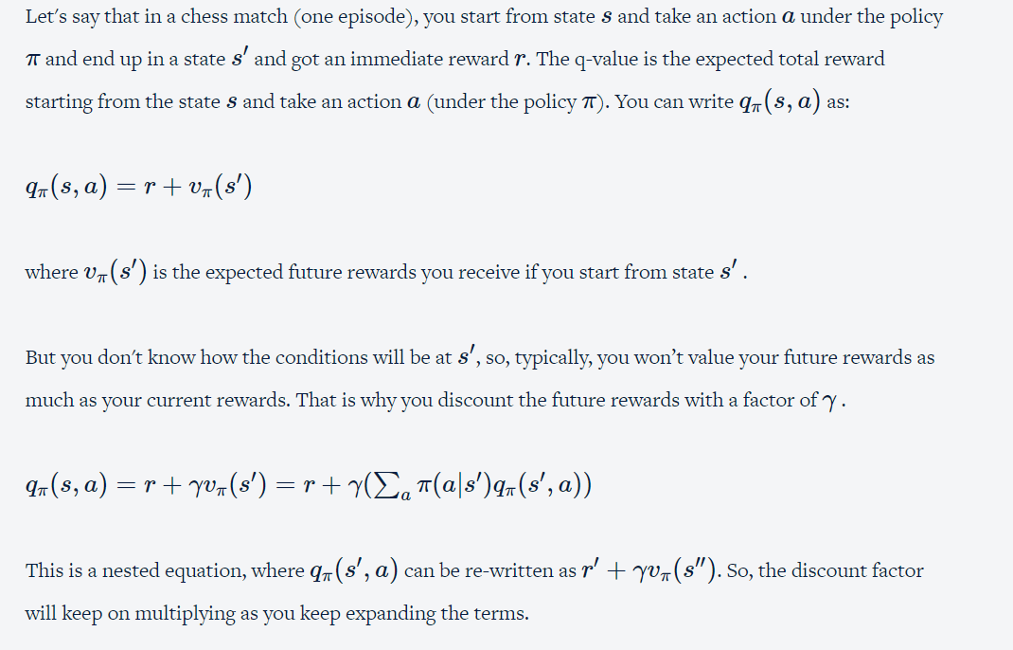

Slide 48
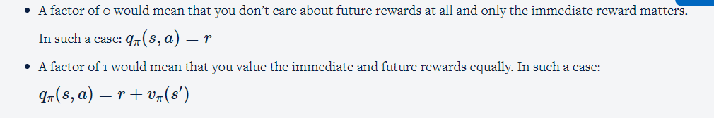
This discount factor determines the importance of future rewards, i.e. how much you value the future rewards.

Slide 49
Another important feature of having a discount factor is for continuous tasks. When total rewards are calculated for continuous tasks, the total rewards may not converge. So, the discount factor will keep the total rewards bounded.
This is a single game. But the opponent won't be playing with the same strategy every time, right? The same applies to the environment. We could have gotten a different reward and ended up in a different state. So, to calculate the expected value of qπ(s,a), you need to play the game, again and again, to account for all possible combinations of s′ and r .

Slide 50
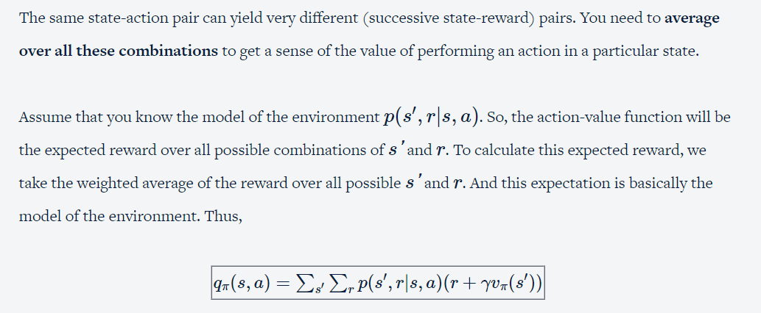

Slide 51
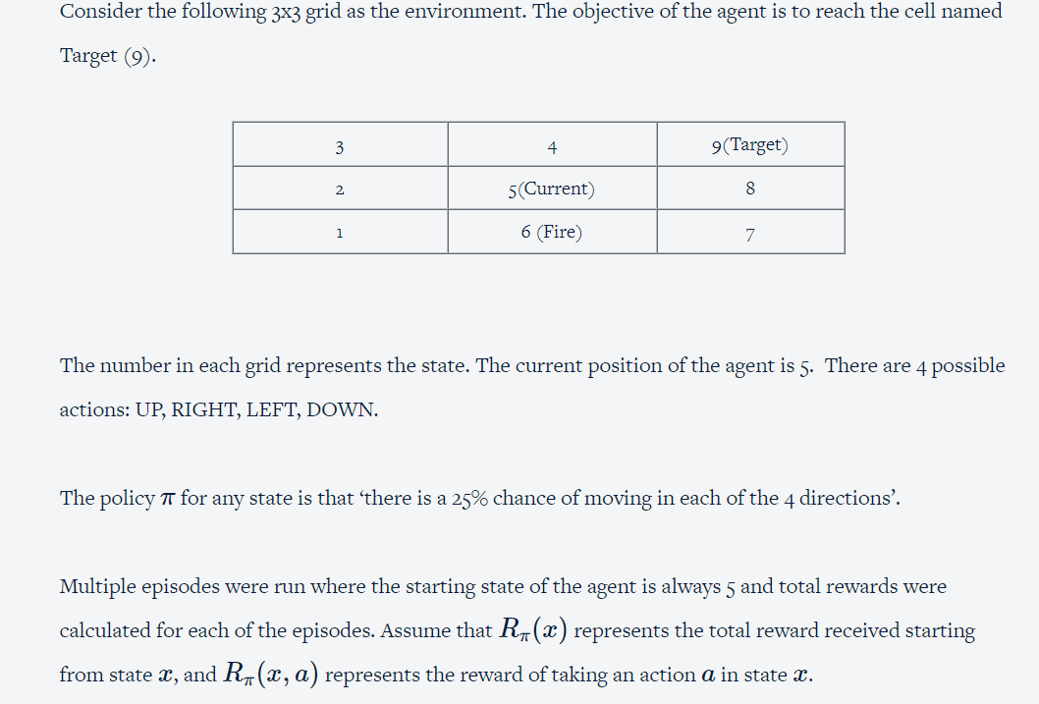

Slide 52
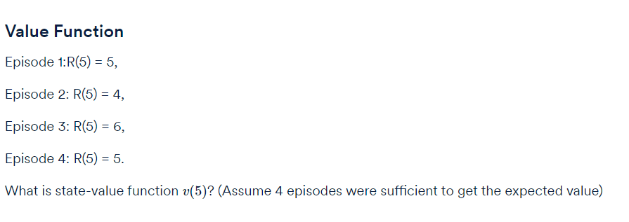
Q1

Slide 53
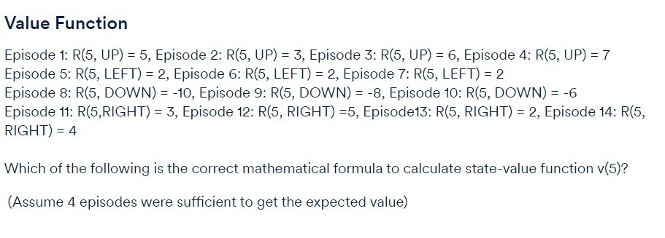
Q3

Slide 54
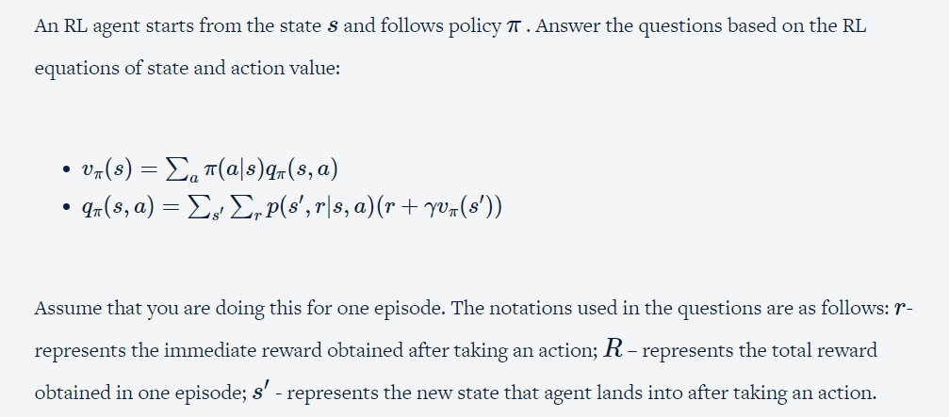

Slide 55
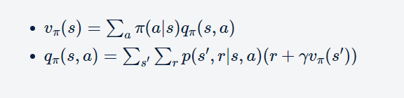
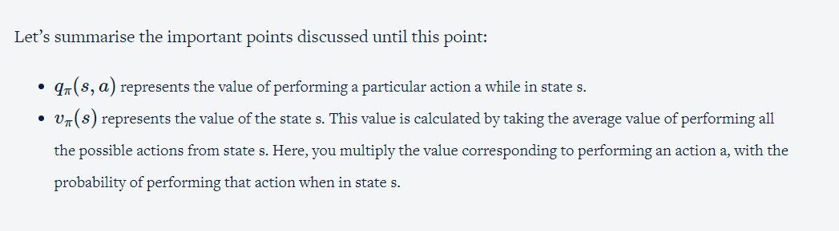
Understanding the RL Equations

Slide 56
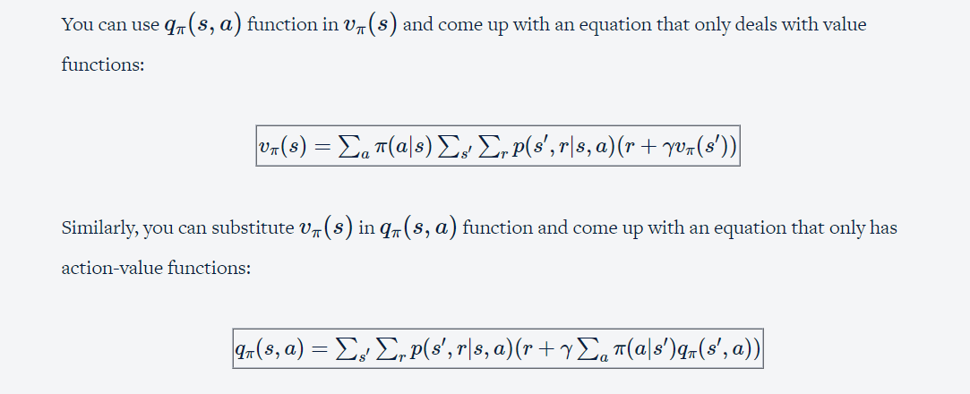

Slide 57
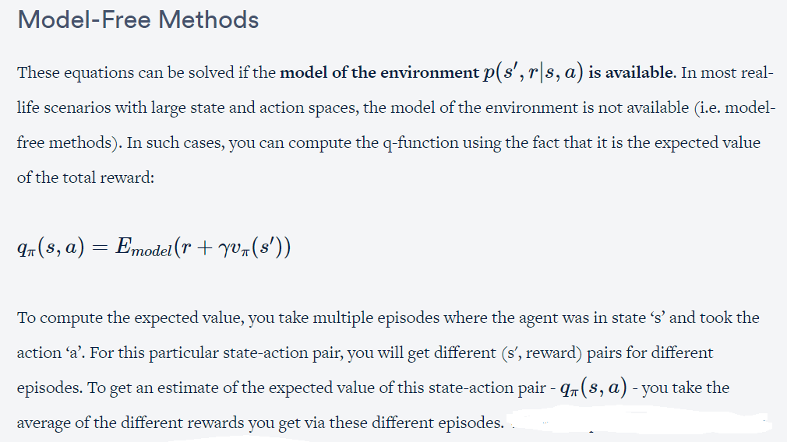

Slide 58
Formal justification of using q-value not value-function in model-free methods:
Now, to compute the value function, you need to evaluate q-function. And given that you don't have the model of the environment, you can't directly evaluate q-function, thereby, can't substitute q-function in value function equation. And this is a typical scenario.
Intuitively, with a model, value-function is enough to find an optimal policy, as the agent can look ahead one step and choose the action that leads to the best combination of reward and state. But without a model, the agent needs to estimate the value of each action to find an optimal policy.

Slide 59
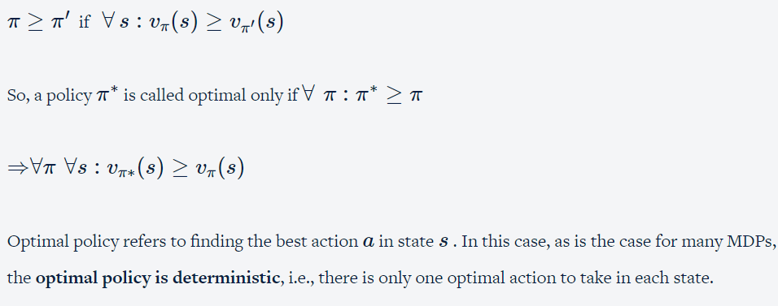
Bellman Equations of Optimality
Till now, you have learnt how to calculate state-value and action-value functions for a policy π.you will learn to write similar equations for an optimal policy.
A policy π is better than π′ if, for all states, the value function is higher if you follow policy π than if you follow policy π′. In other words:

Slide 60
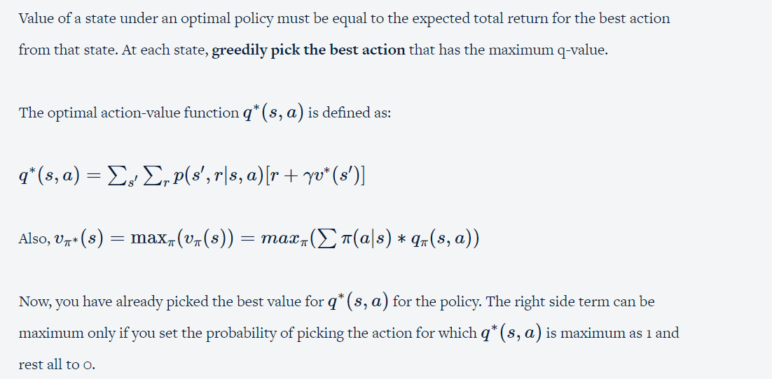

Slide 61
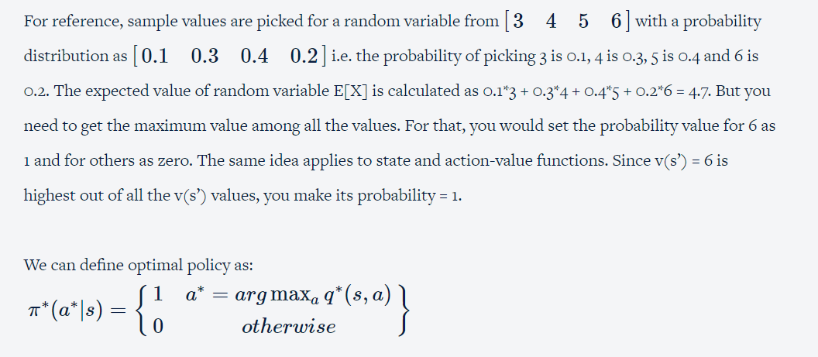

Slide 62
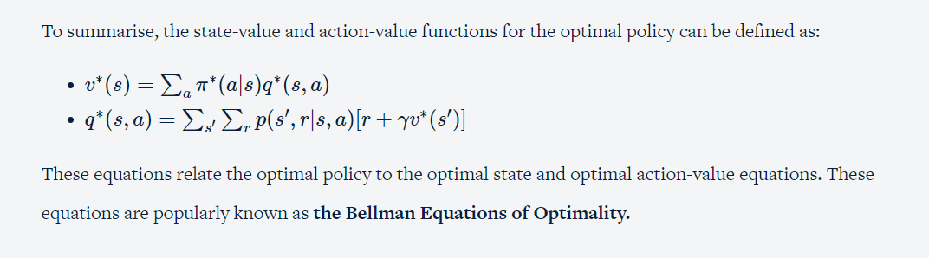

Slide 63
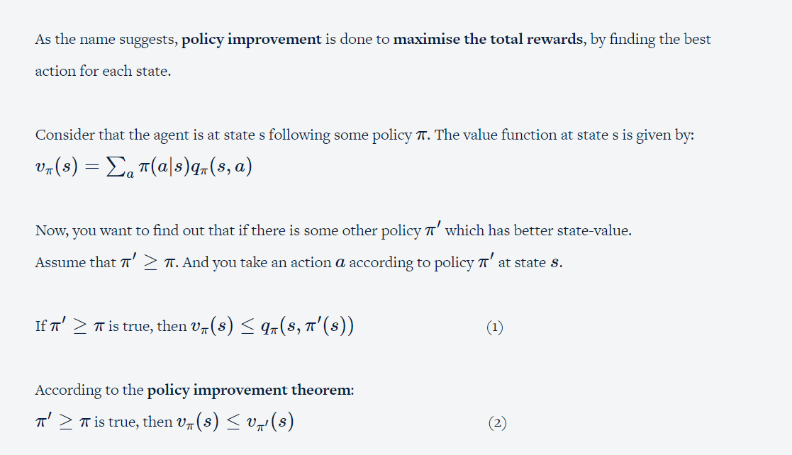
Policy Improvement

Slide 64
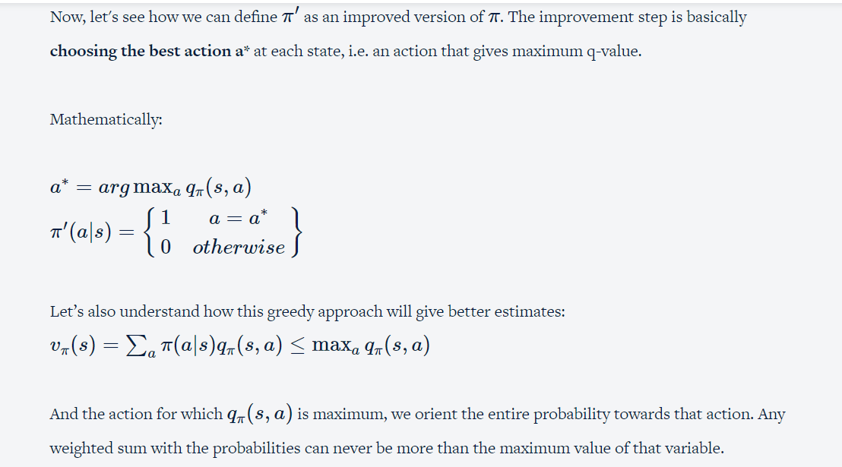

Slide 65
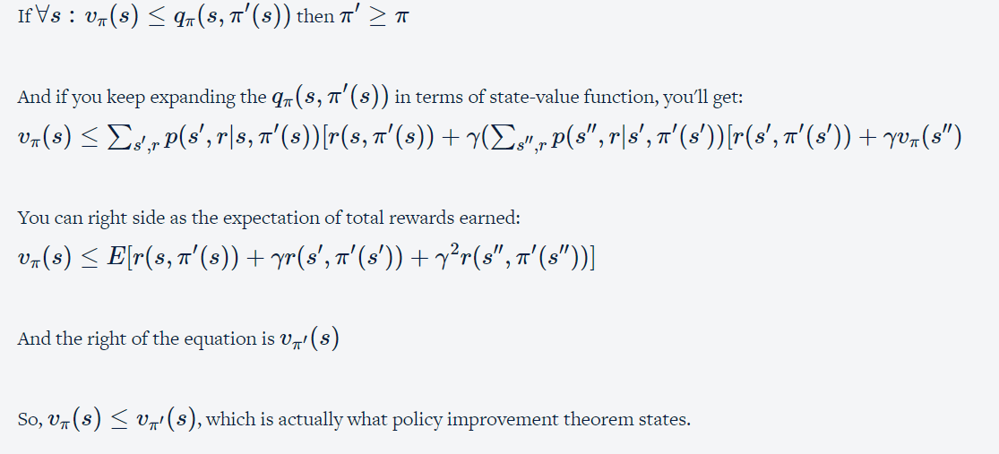
Policy Improvement Theorem Proof

